Slide 1
Module 12: Class Closing

Slide 2
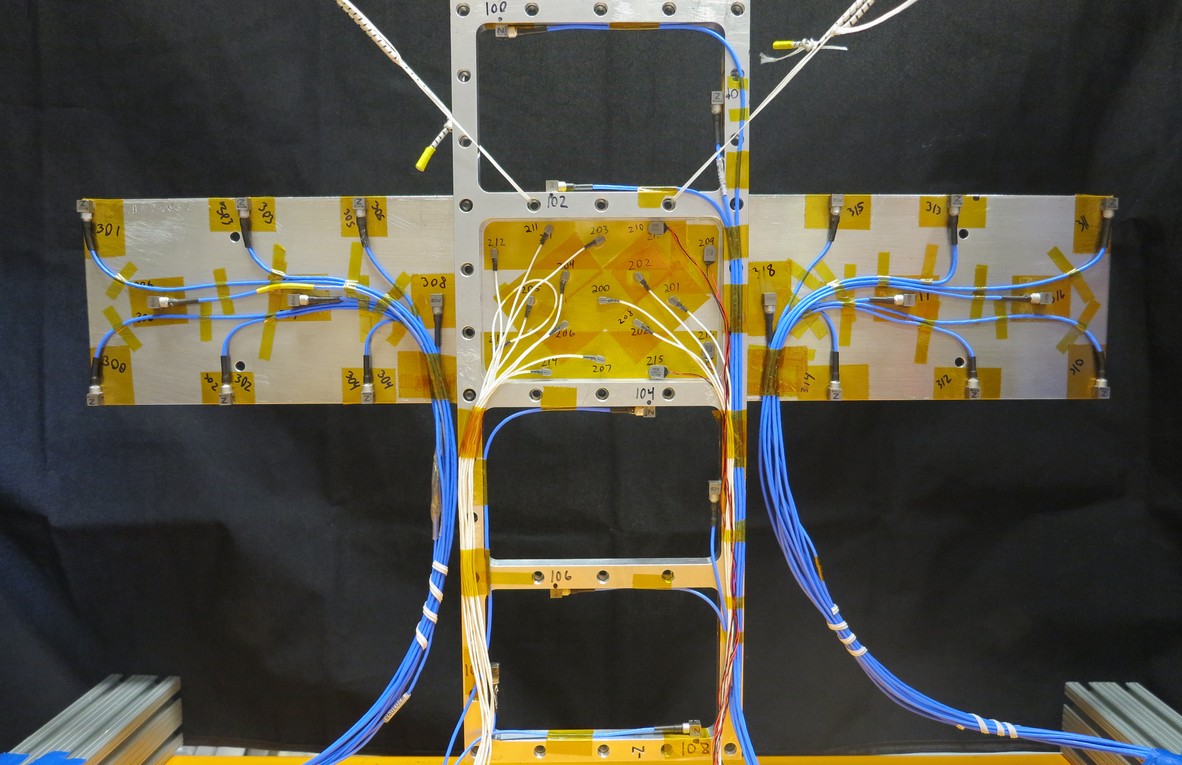
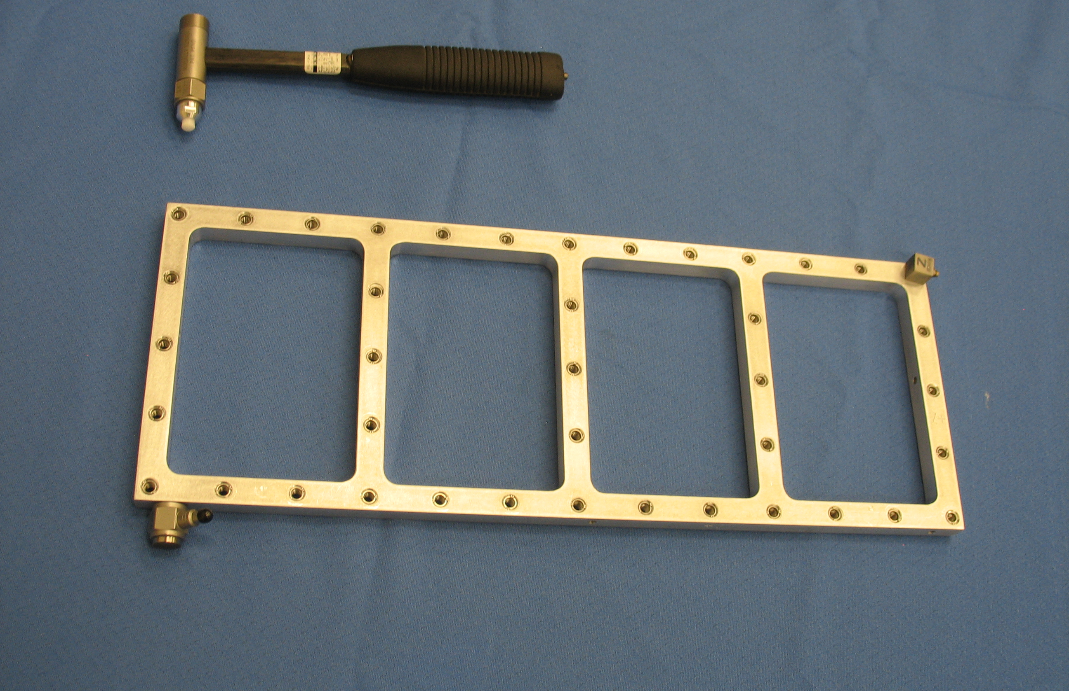
Agenda
Module # | Title | Planned Timing
1 | Introduction | 9:00-9:20
2 | Physical Coupling | 9:20-10:00
3 | Frequency Based Substructuring | 10:00-10:40
- | Break | 10:40-10:50
4 | Component Mode Synthesis | 10:50-11:20
5 | In Class Exercises I | 11:20-Noon
- | Lunch | Noon-1:00
6 | Experimental Considerations | 1:00-1:45
7 | Frame Wing Experimental Example | 1:45-2:30
- | Break | 2:30-2:40
8 | Transfer Path Analysis | 2:40-3:10
9 | Virtual Point Transformation | 3:10-3:40
10 | Decoupling | 3:40-4:10
11 | Nonlinear Component Mode Synthesis | 4:10-4:40
12 | Course Conclusions | 4:40-5:00

Slide 3
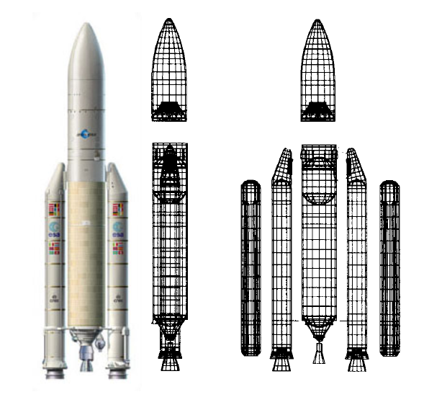
What Is Substructuring?
Substructuring is a process whereby individual components of a structure are analyzed or tested separately and then combined to predict the response of the built-up structure.
Reduced Order Modeling: create an approximation to a model to reduce the computational burden
Analytical substructuring forms the basis of the Finite Element Method, and related techniques, such as the Craig-Bampton method, have been key components of structural analysis for over 40 years.

Slide 4
What is Experimental/Analytical Substructuring?
Experimental/Analytical Substructuring is a far less common variant where a model for one or more subcomponents is derived experimentally.
Often we are tasked with analyzing systems where one or more components are difficult to model analytically
Unknown material properties
Complicated Geometry
Produced and designed by an outside vendor
The dynamics of these parts can have profound impact on the system level performance
Experimental models are often the optimal choice for characterizing the impact of non modeled hardware it’s the system level response
Experimental-analytical substructuring allows one to couple experimental results from these test to high fidelity finite element models

Slide 5
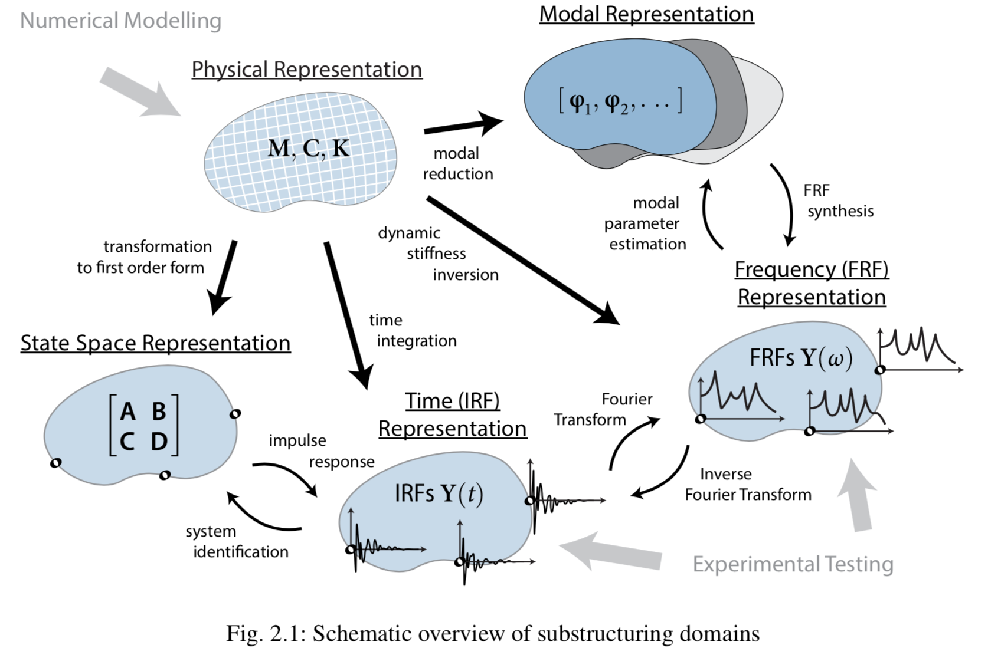
Domains for Substructuring

Slide 6
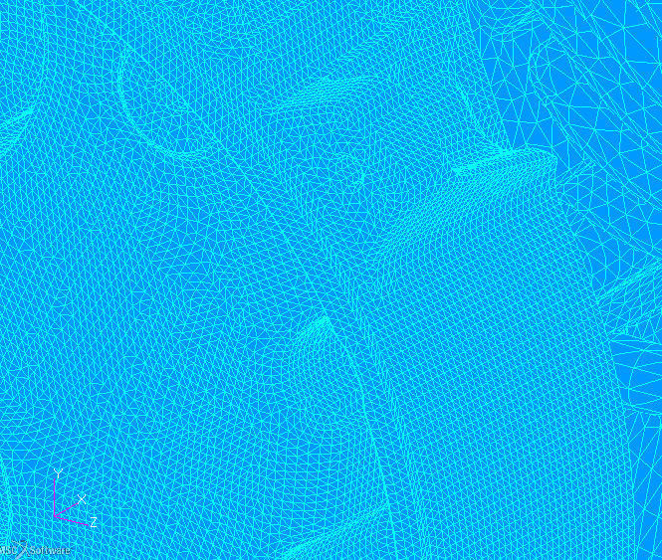
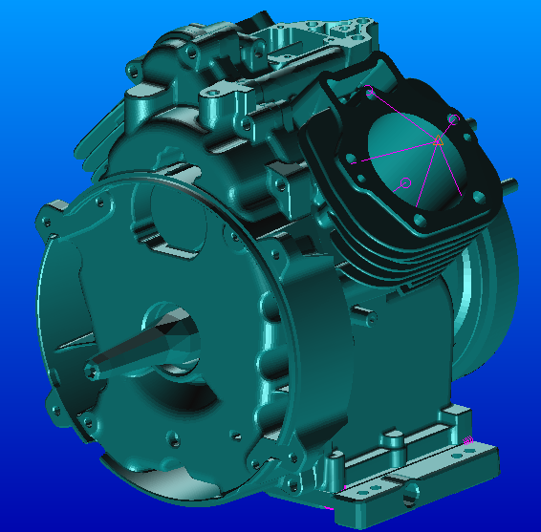
Relation to Reduced Order Modeling
A complete FEA model allows for arbitrary motion of any node of the structure.
A substructure or reduced order model can be more efficient by capturing only those motions that are likely in the application of interest.
This is especially relevant to structural dynamics, where the deformations observed are often the net effect of only a few vibration modes.

Slide 7
Additional Topics
There are many additional topics to discuss in substructuring
Please join us for a social hour to discuss more questions and ideas around structural synthesis or attend the substructuring tracks at IMAC on Wednesday/Thursday
Thanks for your attention and class participation!

Slide 8
Check the GitHub for occasional slide updates and additional modules

